Slide 1






























INDEN Fe validation
R. Capote (IAEA) and A. Trkov (JSI, Slovenia)
Nuclear Data Section, International Atomic Energy Agency
On behalf of the INDEN collaboration

Slide 2
Background
Original work was done in the framework of the OECD/NEA WPEC SG-40 (CIELO) Collaboration
CIELO iron evaluations were adopted for ENDF/B-VIII.0
Good performance was demonstrated for criticality problems
Detailed benchmarking revealed degraded performance in modelling leakage spectra through thick shields with ²⁵²Cf and D-T sources
Since then, additional work was performed to remove the deficiencies

Slide 3
Scope
Fe-56 inelastic cross section
Benchmarks:
  IPPE Cf-252 (70 cm diameter)
  Rez Cf-252 (100 cm diameter)
  IPPE 14 MeV (60 cm diameter)
  TIARA
  Criticality
  PCA benchmark (S.van der Marck)
  Fusion 1D ITER blanket model (Tim Boehm)

Slide 5
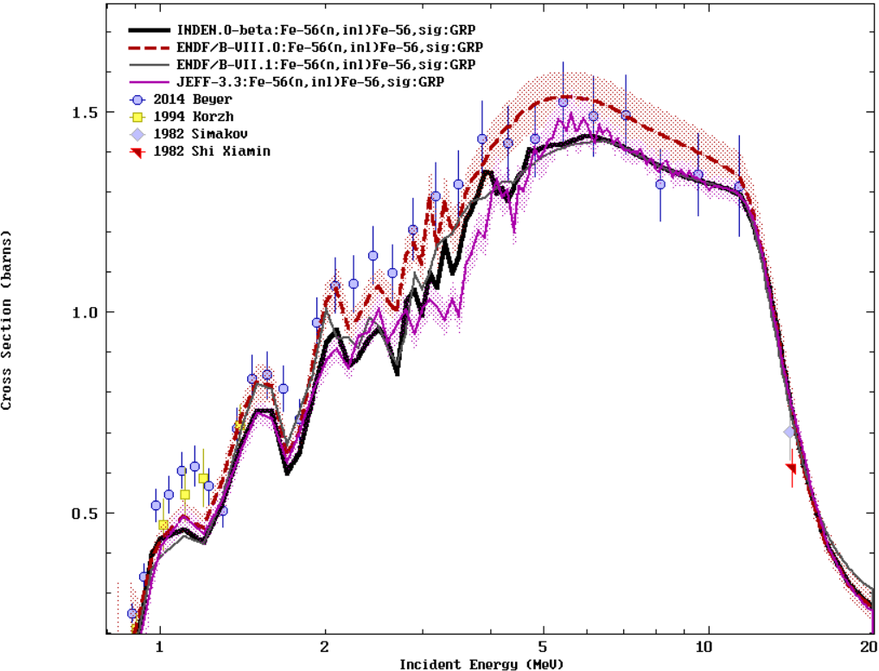
INDEN Fe: major reduction in ⁵⁶Fe(n,n’)
⁵⁶Fe(n,n’)
10-20% reduction

Slide 6
²⁵²Cf(sf) neutron leakage: 70 cm sphere

Slide 7
²⁵²Cf(sf) neutron leakage: 70 cm sphere
Elastic scattering windows

Slide 8
²⁵²Cf(sf) neutron leakage: 70 cm sphere
Inelastic cross section

Slide 9
²⁵²Cf(sf) leakage: 100 cm Rez sphere

Slide 10
14 MeV neutron leakage: 60 cm sphere

Slide 11
14 MeV neutron leakage: 60 cm sphere

Slide 12
TIARA Leakage through 1m slab
Notes:
ENDF/B-VII.1 and JEFF-3.3 are completely off even in the elastic peak
e71Fe-jHE is run with JENDL-4/HE iron data (negligible impact of other materials)
Performance of INDEN iron is comparable to JENDL-4/HE

Slide 13
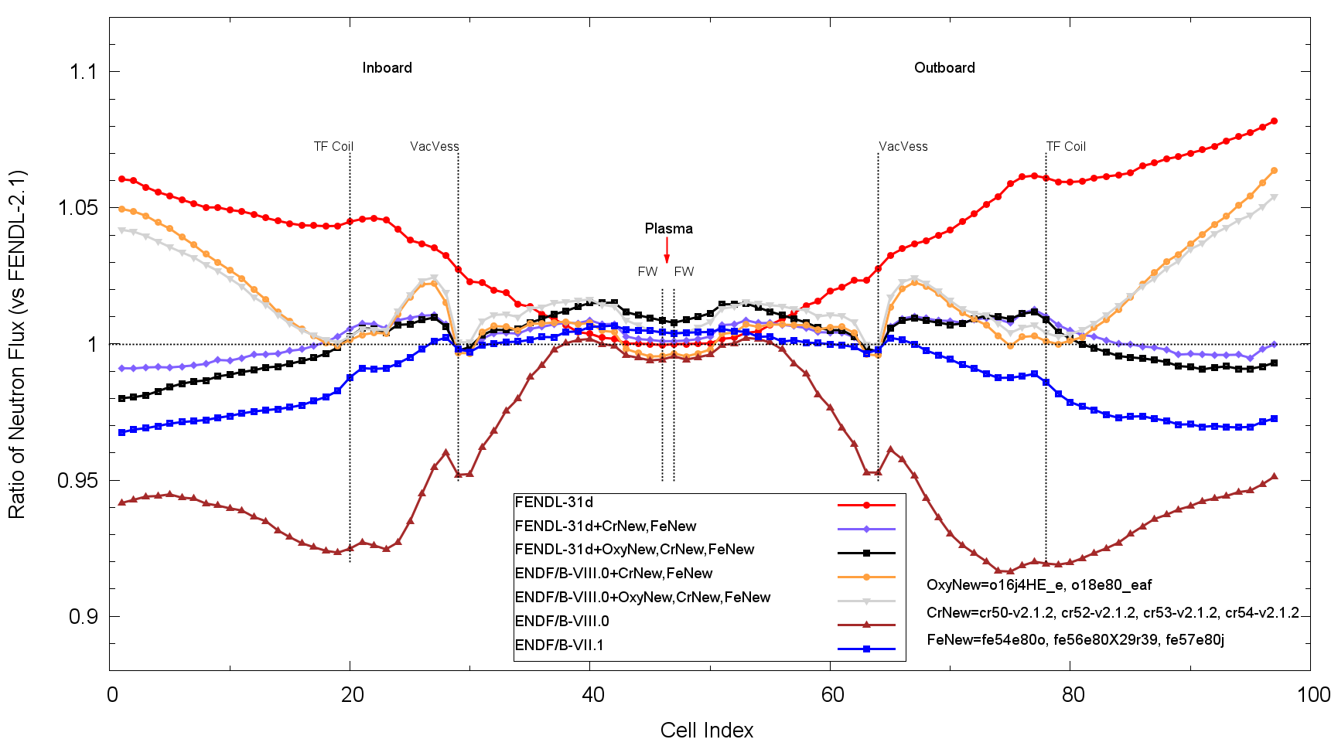
ITER 1-D Cylindrical Benchmark
Note, this is relative to FENDL-2.1 data !
Courtesy of Tim Bohm, University of Wisconsin-Madison, USA
Notes:
CrNew, FeNew restore agreement with FENDL-2.1, OxyNew effect is small
ENDF/B-VIII is still high at the outer boundaries – not due to Fe, Cr, O-16

Slide 14
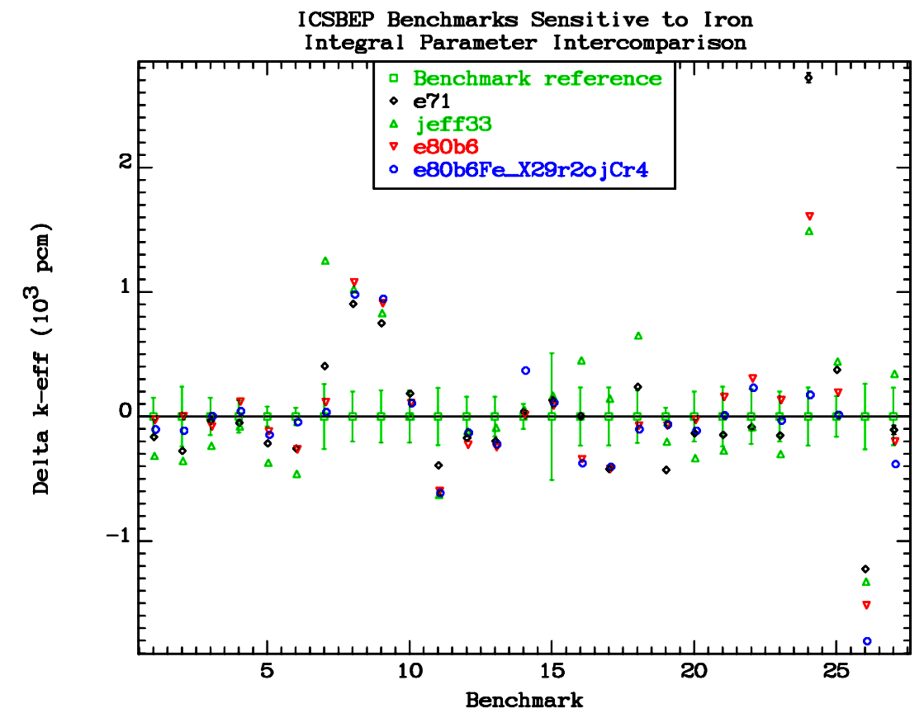
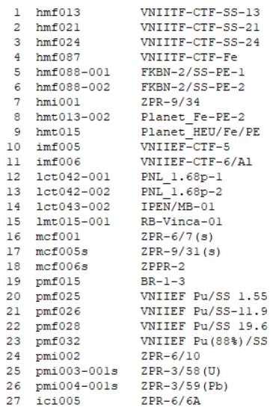
Criticality impact of Fe/ ⁵³Cr – St.Steel
ENDF/B-VII.1
JEFF-3.3
ENDF/B-VIII.0
INDEN (new)
Criticality performance improved (blue vs red)
Cr σ_{γ} =>
-1200 pcm
⁵⁶Fe
σ_{γ}(th)
^{BNL/ORNL/IAEA}
^{Cr evaluations}
⁵³Cr σ_{γ}
⁵⁶Fe
σ_{γ}(th)
5), 6) hmf088 (1&2)
24) pmi002 (-1.2%)
X 14) lct043.002

Slide 15
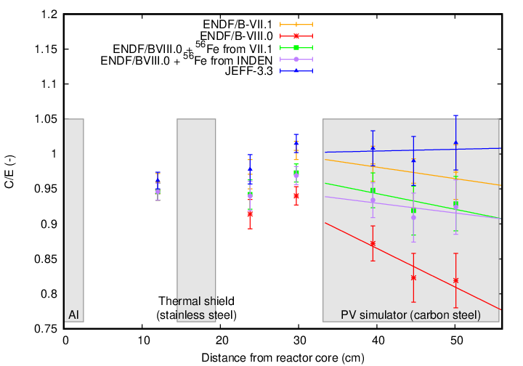
PCA reactor benchmark
Courtesy of Steven van der Marck (priv. comm.)
Sensitivity
¹⁶O(n,α)?
High Sensitivity Fe
n
water
water
Notes:
All libraries under-predict flux at the first point – this could be an indication of a too-low fast spectrum contribution.
Normalization to the first point would make INDEN flat over the entire mockup assembly.

Slide 16
Conclusions
Deficiencies of the ENDF/B-VIII.0 (CIELO) iron isotope evaluations were corrected:
  Inelastic cross section of Fe-56
  Elastic cross section minima in RRR
  Inelastic cross section of Fe-57
In combination with other INDEN evaluations:
  Performance in criticality problems at least as good or better.
  Solved problems of flux under-estimation in leakage from thick iron spheres (Cf-252 and D-T sources) and flux overestimation around 300 keV.
  Good performance in deep penetration problems at higher energies (43 MeV TIARA benchmark).

